Slide 1
Challenges And Solutions In Agile EA

Slide 2
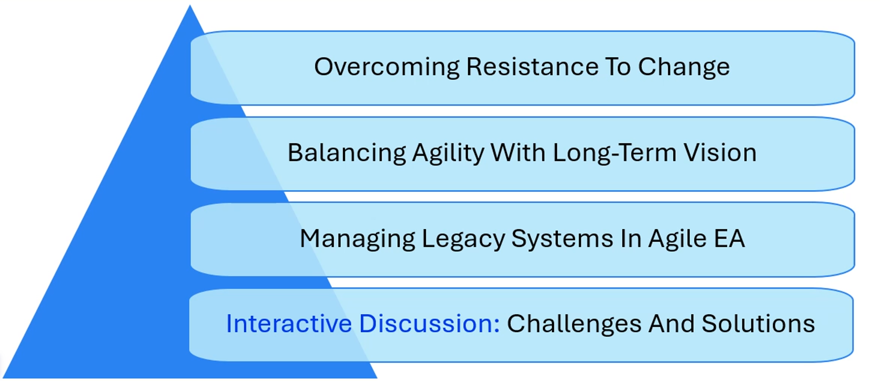
Challenges And Solutions In Agile EA

Slide 3
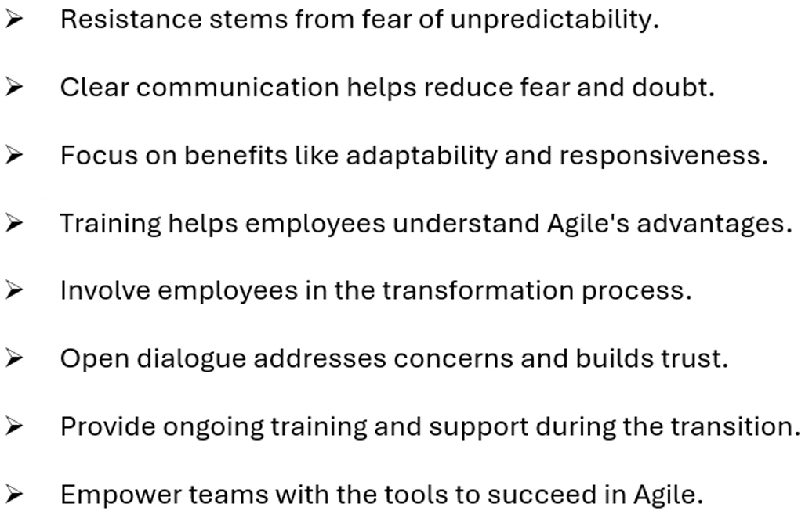
Overcoming Resistance To Change

Slide 4
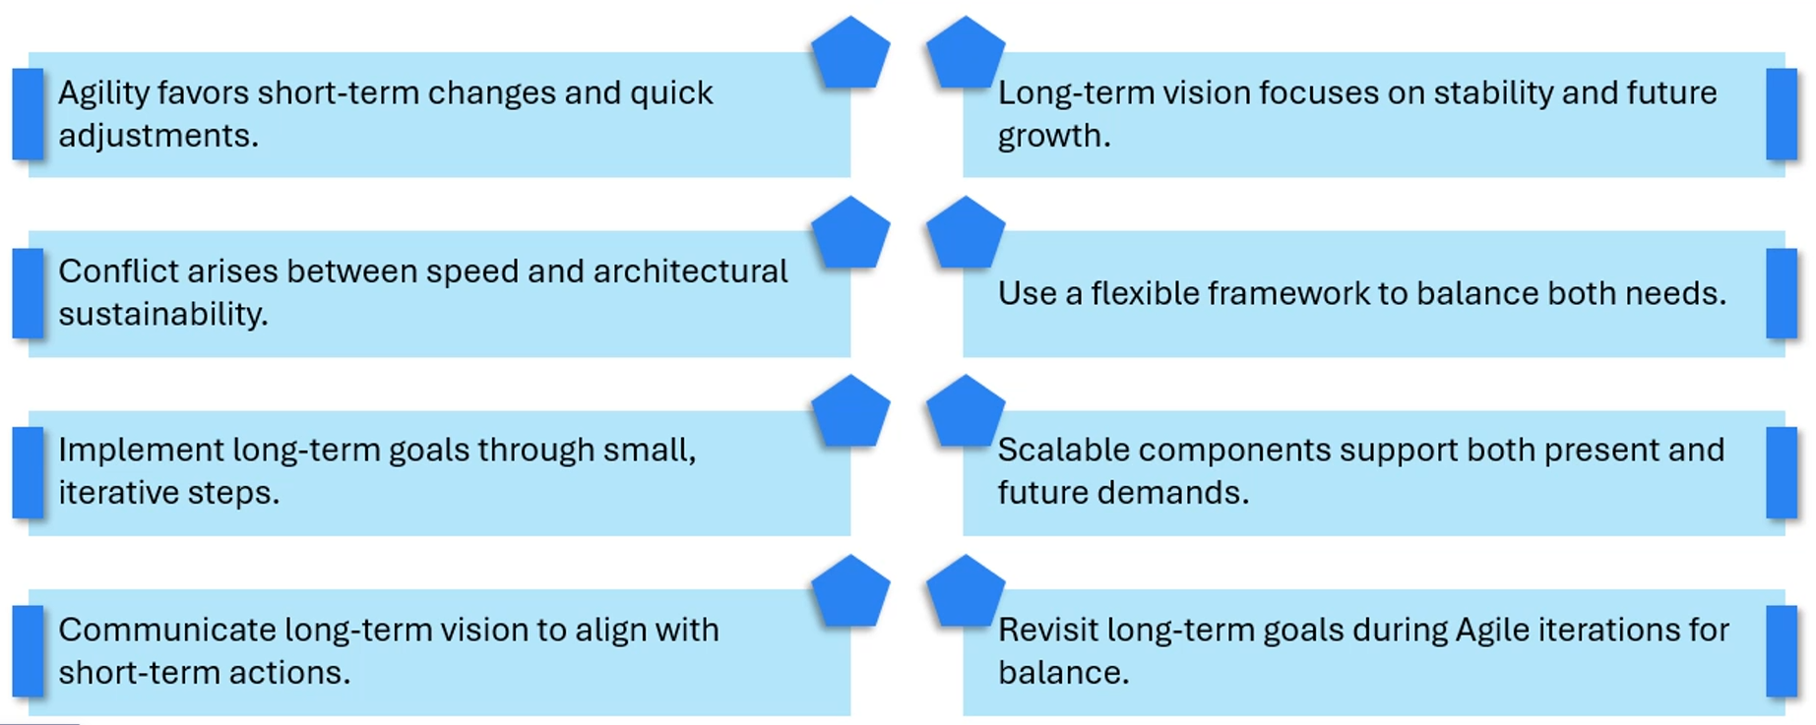
Balancing Agility With Long-Team Vision

Slide 5
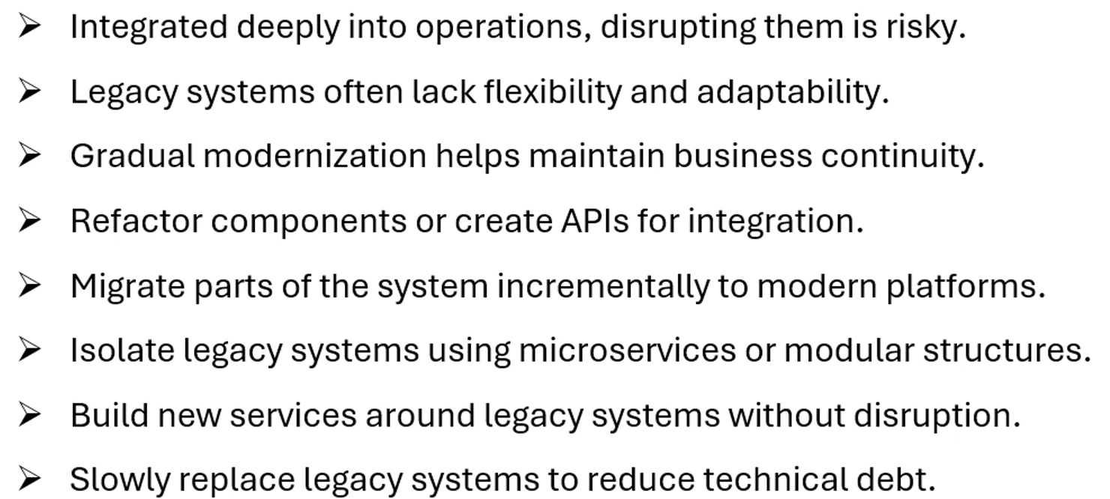
Managing Legacy Systems In Agile EA

